Slide 1

CAR RENT AND PURCHASE APP
Project Supervisor: DR. C. GEETHA M.TECH., Ph.D.
Name of the Student: KIRAN M
Register Number: 41120094

Slide 2
Abstract
The Car Rental and Purchase Management System is a comprehensive Flutter project aimed at facilitating the process of both renting and buying cars through a user-friendly mobile application.
The system caters to the needs of both individuals and businesses, offering a seamless experience for users looking to rent a car for short-term use or purchase a vehicle for long-term ownership.
Users can easily browse through available cars, view detailed information including specifications and rental/purchase pricing, and make bookings or purchases directly through the app.

Slide 3
Problem Statement
Develop a Flutter mobile application that enables users to rent and purchase cars using Firebase as the backend.
The app should provide a user-friendly interface for browsing available cars, making rental or purchase requests, and managing user accounts.
The app should also include features such as real-time updates on car availability, secure user authentication, and seamless integration with Firebase services for data storage and management.

Slide 4
Objectives
The scope of the project includes developing a mobile application using Flutter that caters to both individuals and businesses looking to rent or purchase vehicles.
The app will feature user a catalog of available vehicles with detailed descriptions, pricing, and images, secure payment options, booking/reservation functionality, and a user-friendly interface.
The app will be designed to run on both iOS and Android platforms.

Slide 5
Introduction
Welcome to our cutting-edge car rental and purchase app, built with Flutter and powered by Firebase! Our app offers a seamless experience for users looking to rent or purchase vehicles, all in one convenient platform.
By integrating advanced features such as user authentication, real-time inventory management, secure payment processing, and seamless booking/reservation systems, the project aims to streamline the entire car rental and purchase experience.

Slide 6
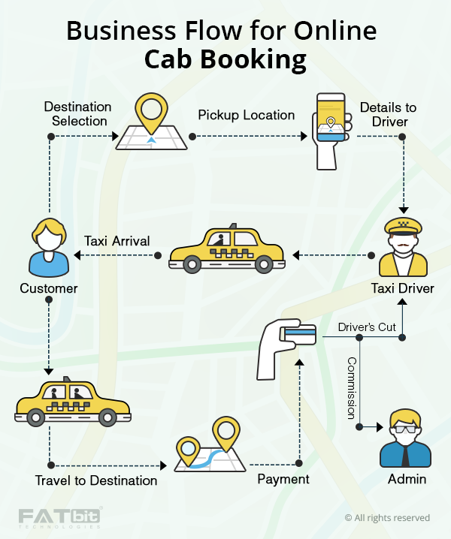
Architecture Diagram

Slide 7
Module1:Splash Screen
The user access page module in a Flutter application serves as a critical component for managing user authentication and authorization.
Authentication is the process of verifying the identity of a user, typically through a username and password combination, while authorization involves determining the user's access rights to specific features or resources within the app.
By integrating Firebase Authentication with Flutter's UI components experience secure authentication .

Slide 8

Module1:Splash Screen

Slide 9
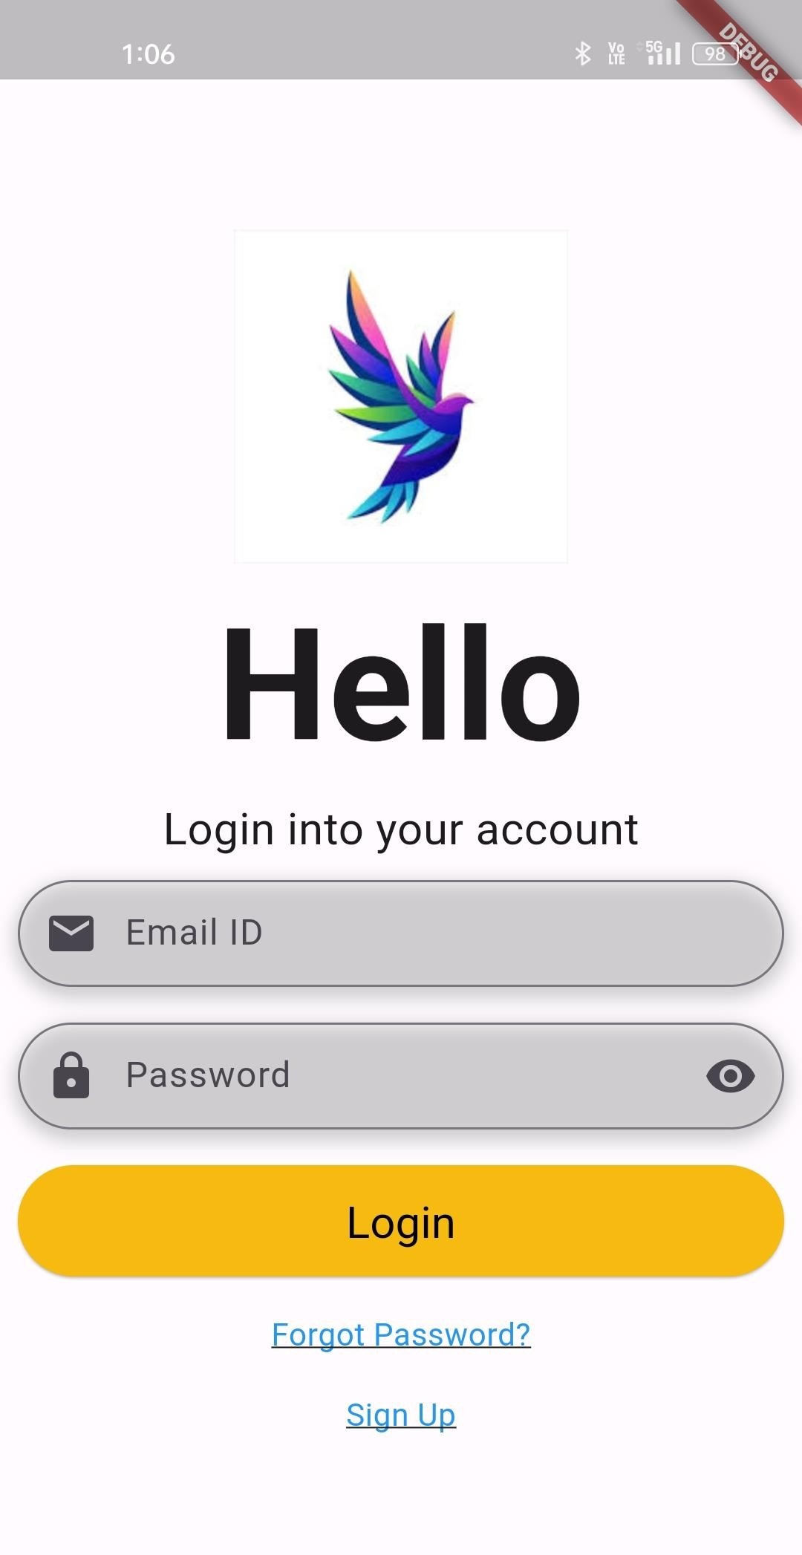
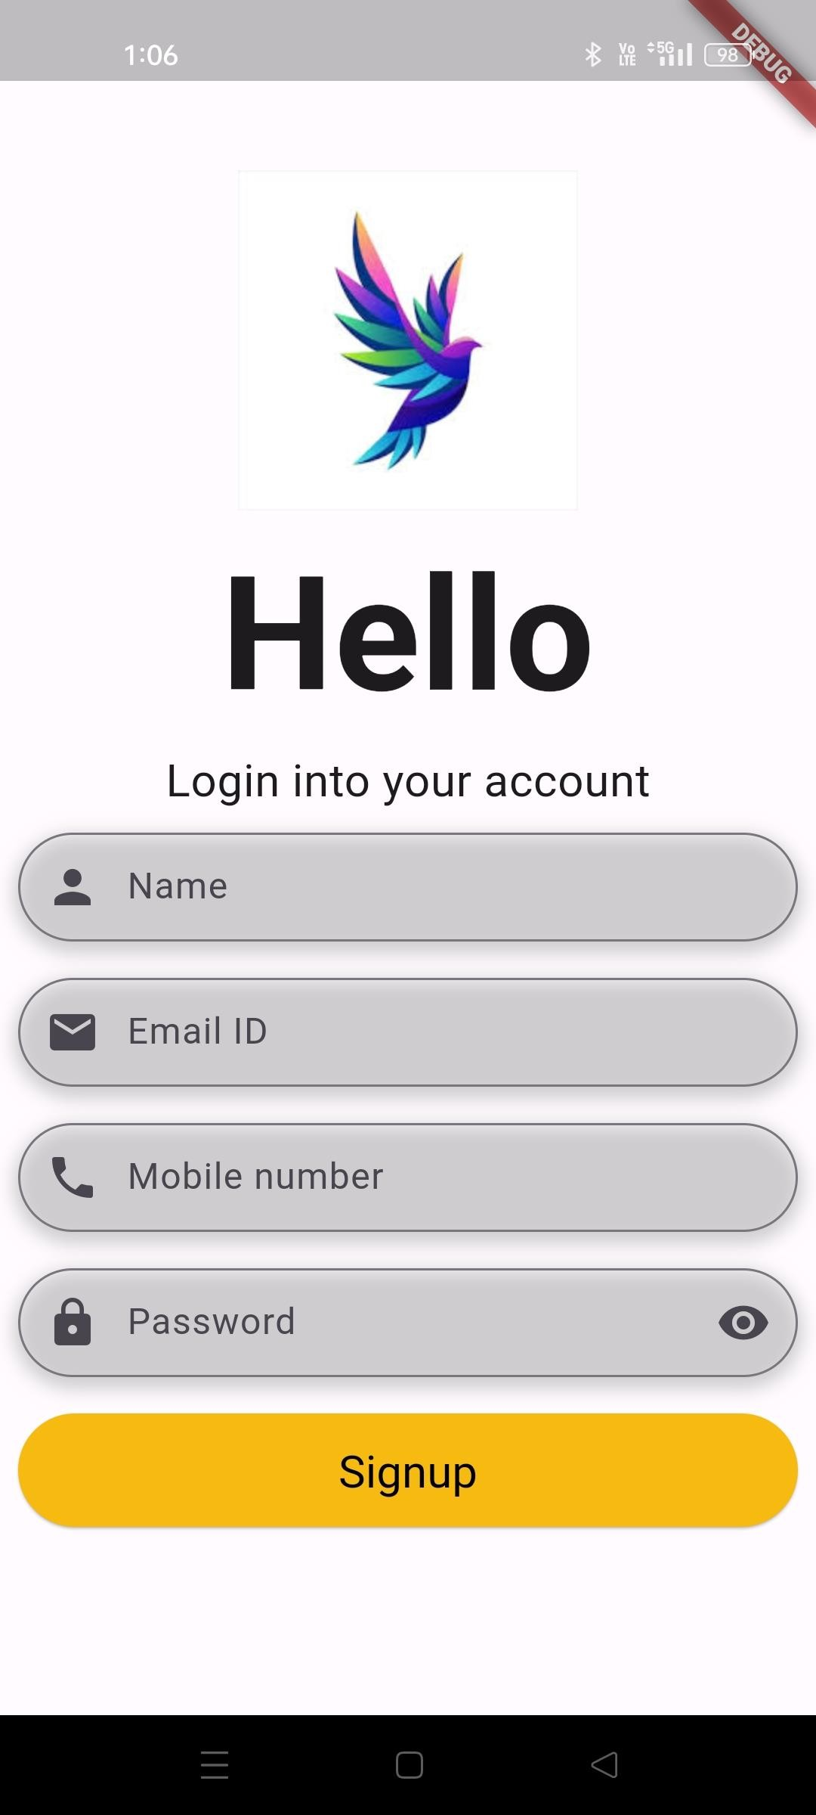
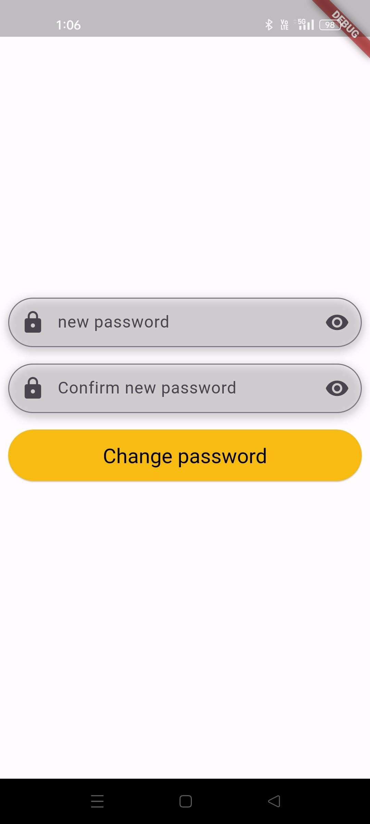
Module2:User Access

Slide 10
Module3:Home page and Car details page
The initial screen of the application, offering users a welcoming interface implemented using a Scaffold widget, the home page consists of an AppBar .
The body of the home page contains various widgets such as ListView, GridView, or Column to display lists of items or other content.
Navigation within the app is managed using the Navigator widget, with the home page often featuring buttons or elements that navigate to different screens.

Slide 11
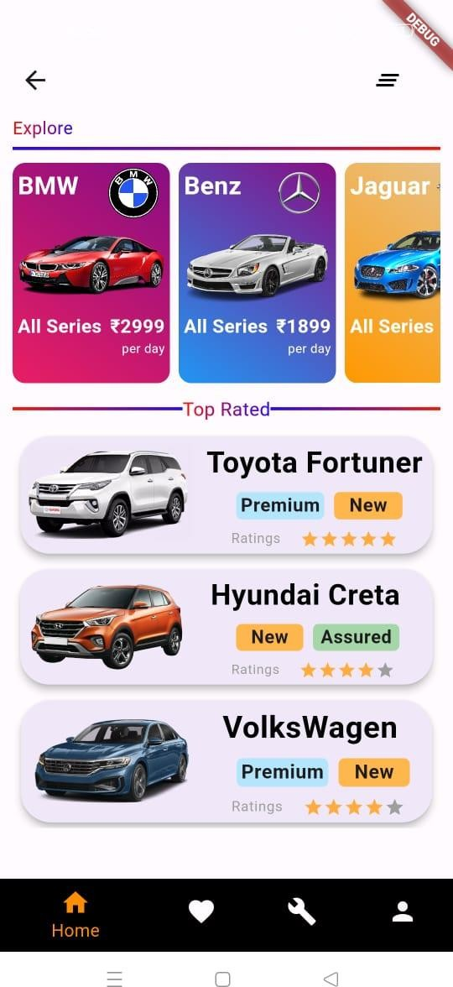
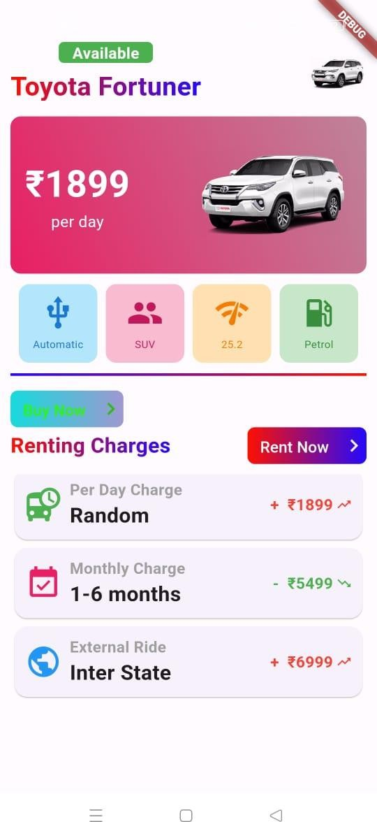
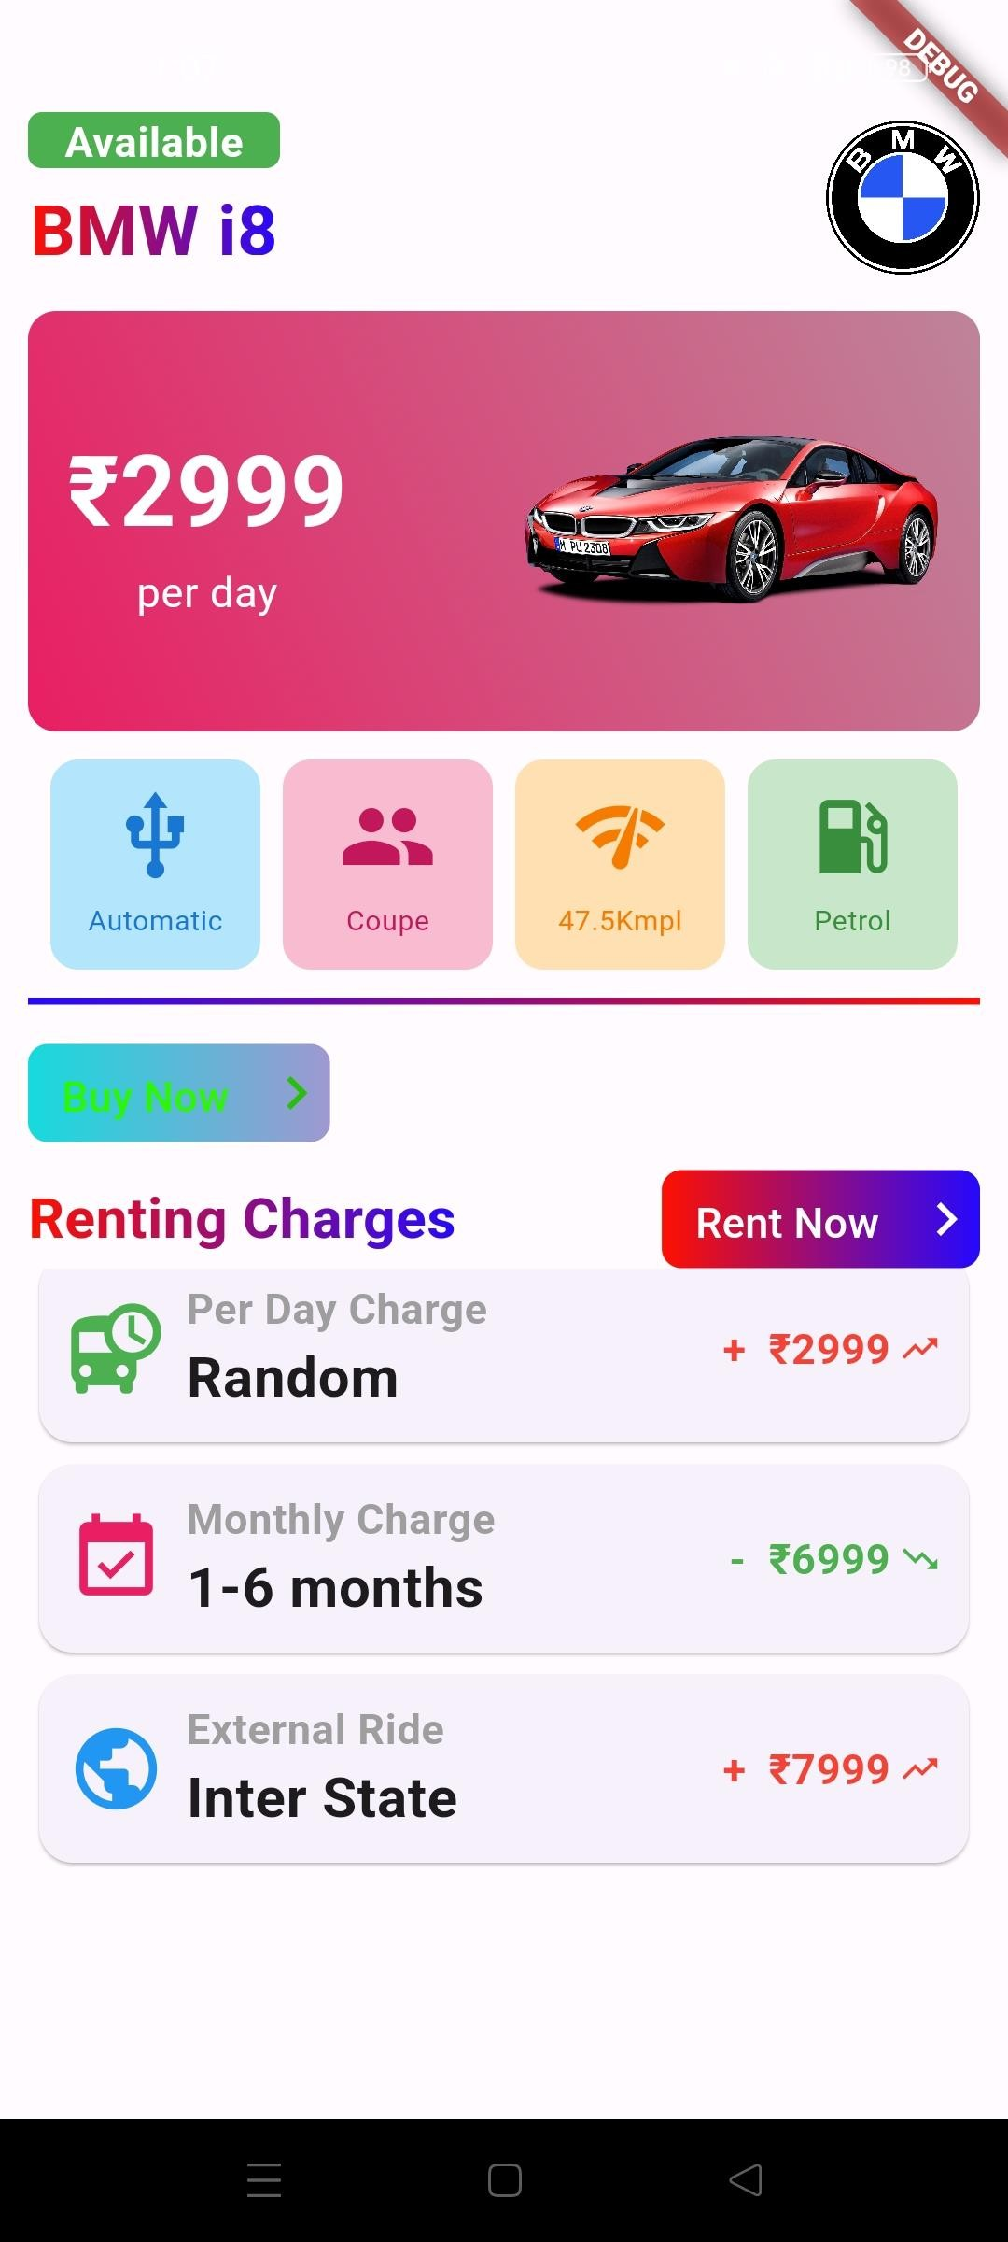
Module3:Home page and Car details page

Slide 12
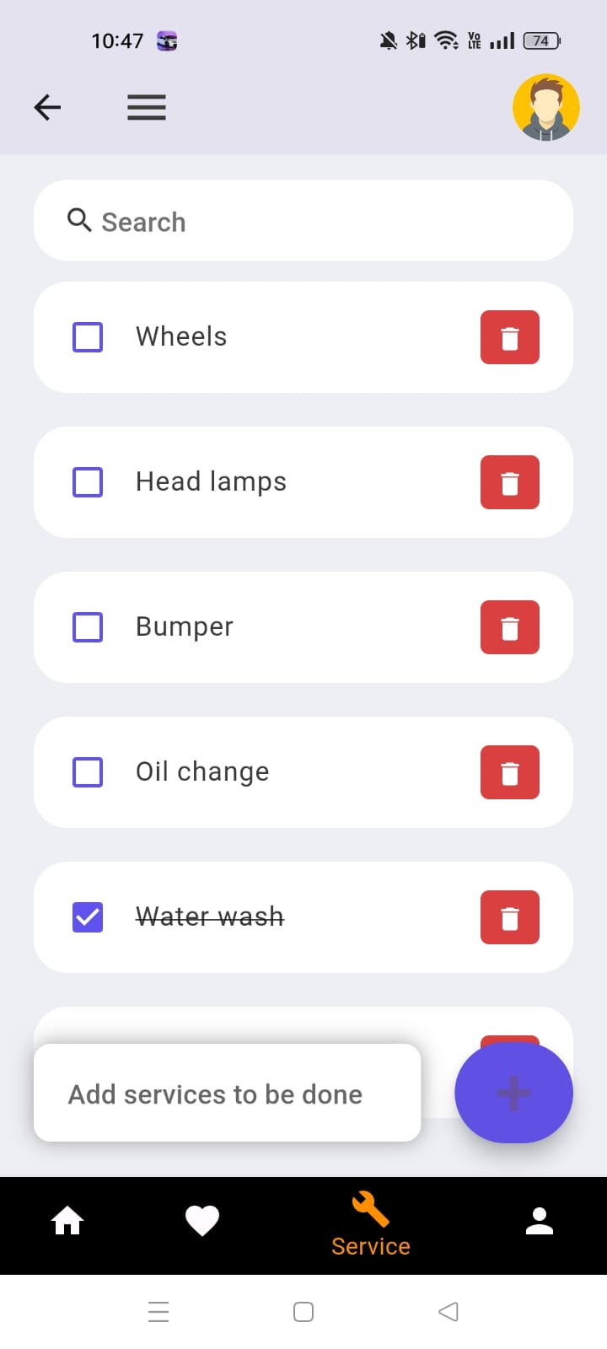
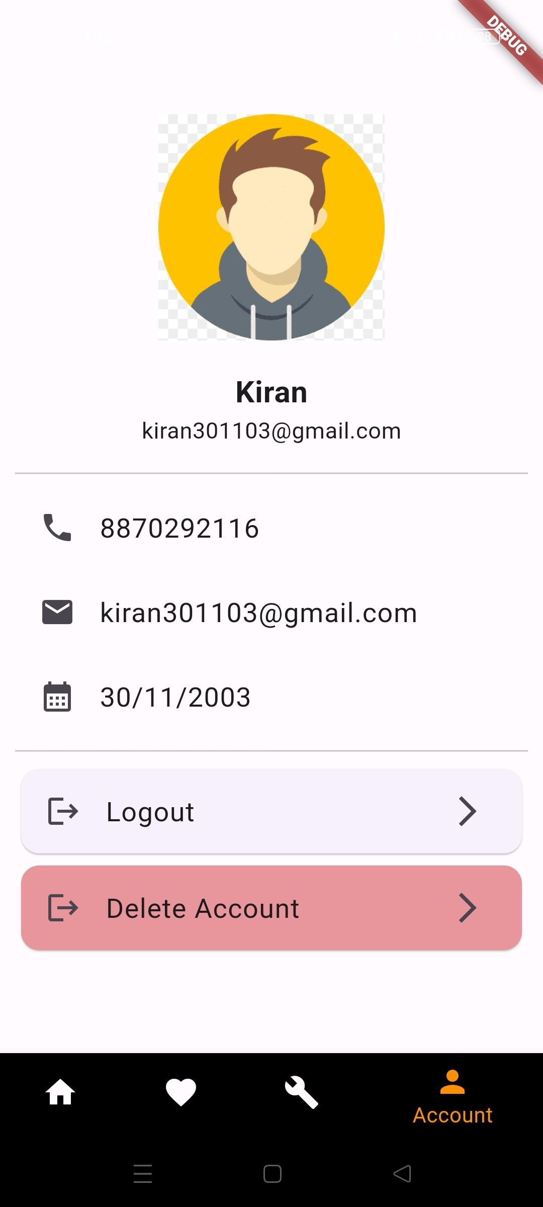
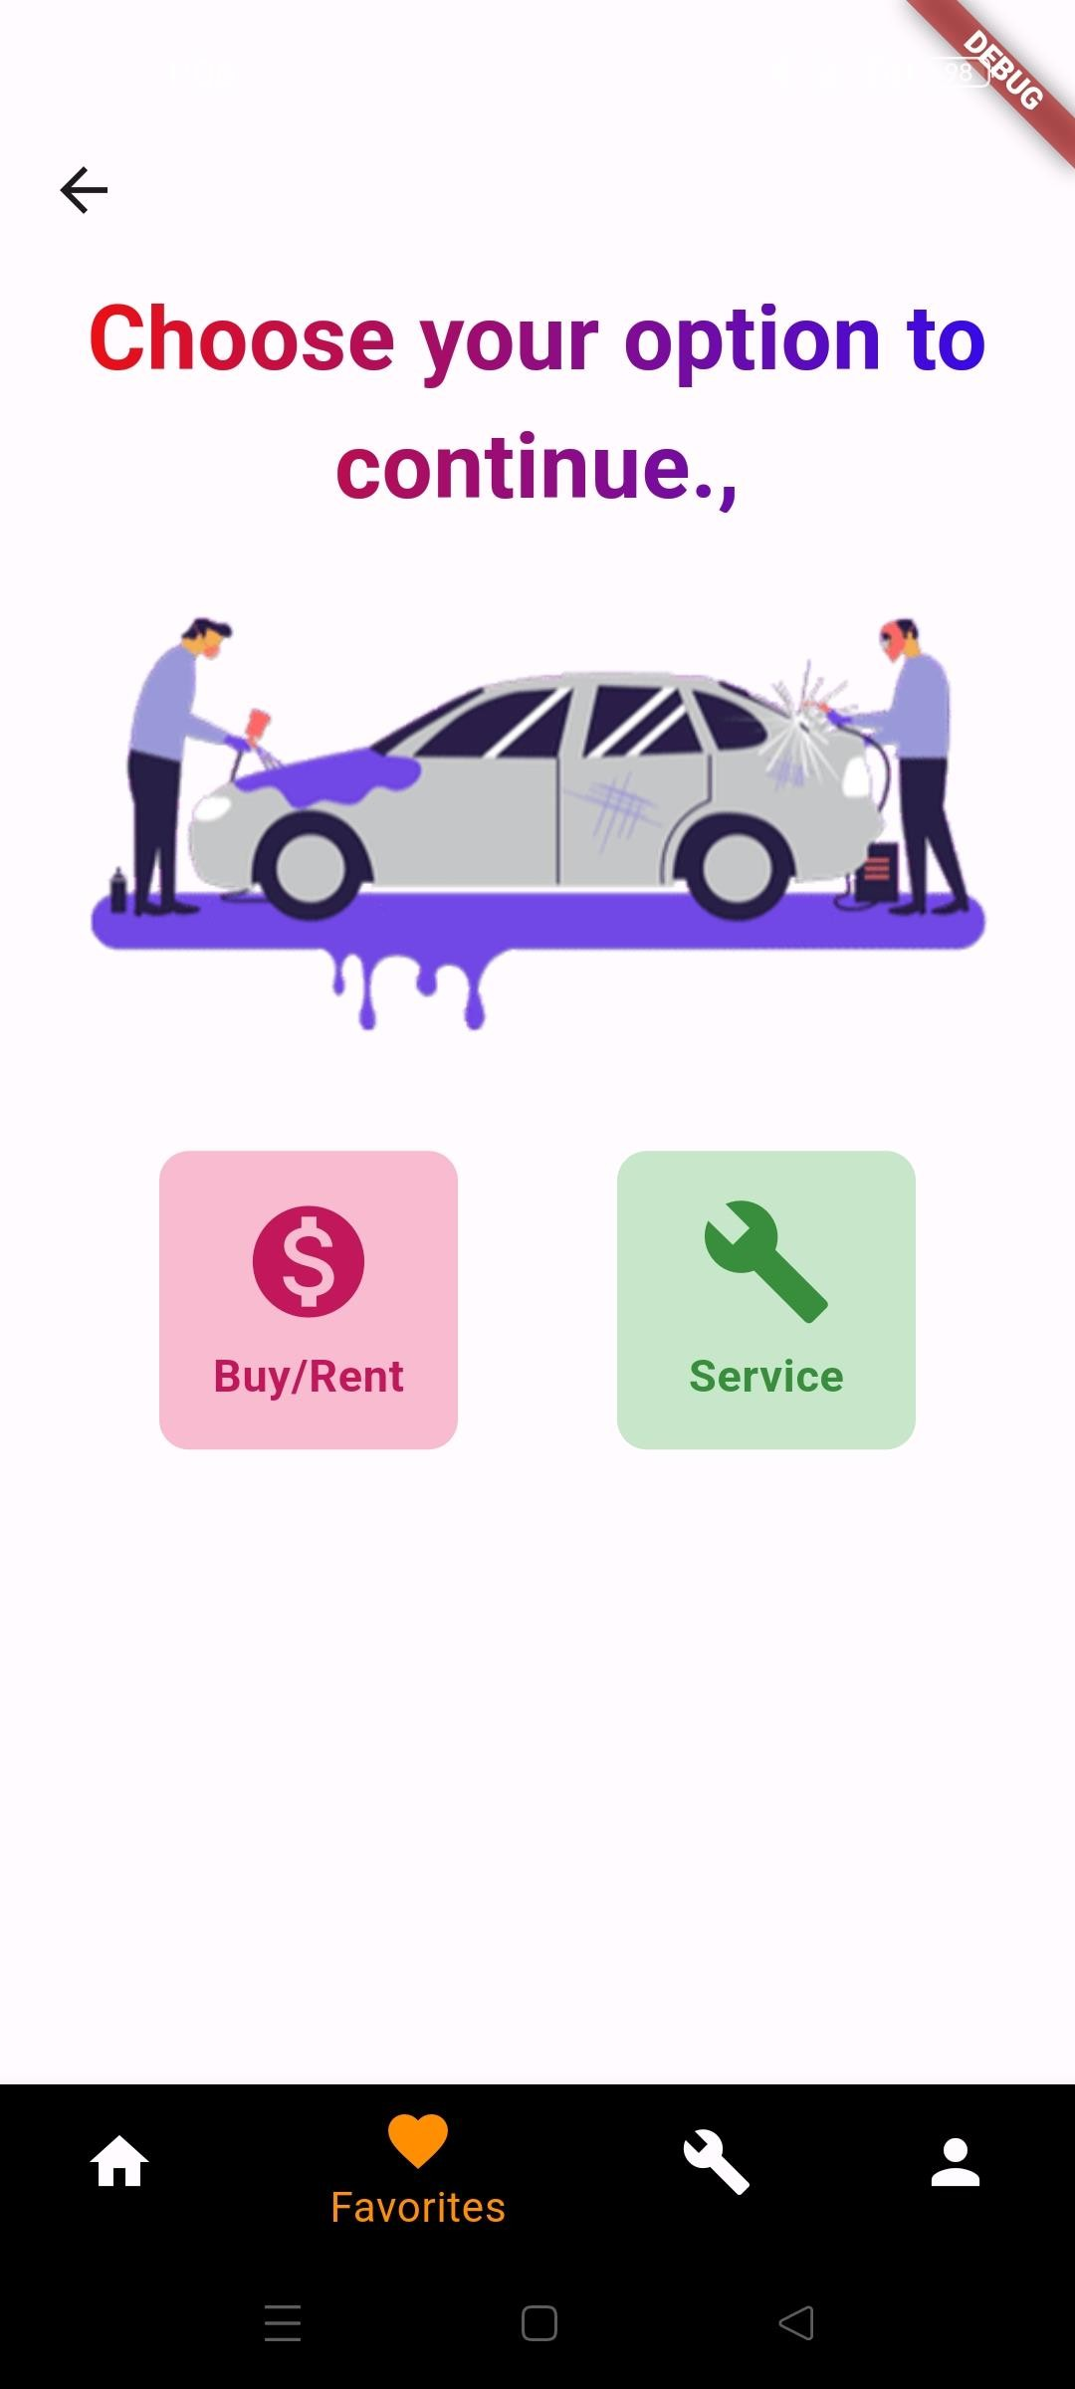
Module4:Navigation bar

Slide 13
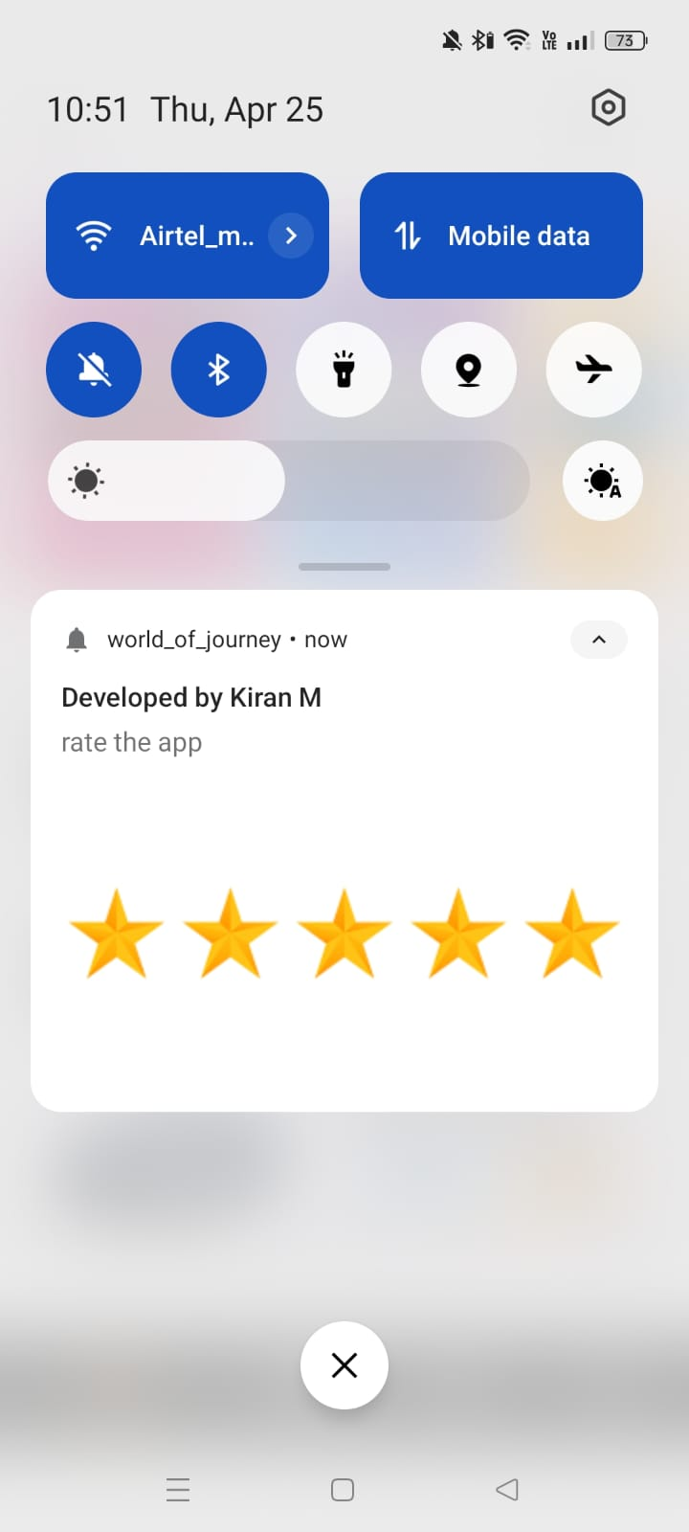
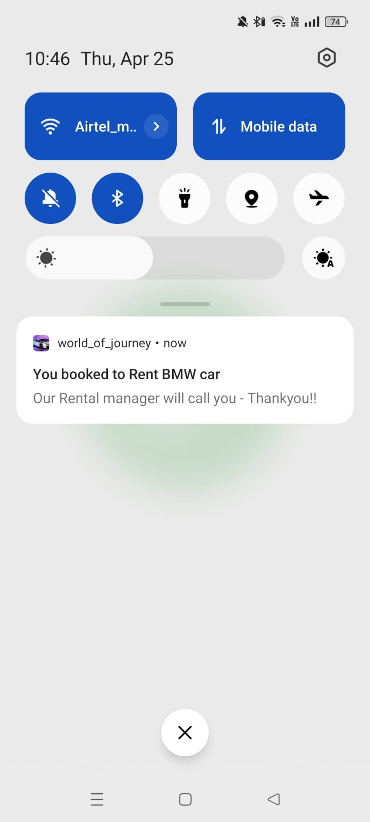
Module5: Notification page

Slide 14
Results and Discussion
Positive feedback on ease of use and convenience, leading to significant user adoption. Sets a new standard for convenience and accessibility in the car rental and purchase market.
Potential for integration with car tracking systems and personalized recommendations based on user preferences.

Slide 15
Conclusion
The Car Rent and Purchase app revolutionizes the way users rent or buy vehicles, offering a seamless, user-friendly experience. With real-time inventory management, and secure payments, it caters to diverse needs. This app redefines mobility, making car transactions convenient and efficient.

Slide 16
References
- Smith, J. et al. (2019). Mobile Application User Experience: Best Practices.
- Johnson, A. (2020). Flutter: A Comprehensive Guide to Mobile App Development.
- Brown, T. (2018). Challenges and Opportunities in the Car Rental Industry.

